Slide 1

PEDIATRIC DERMATOLOGY CASE QUIZ
PRACTICAL APPROACHES TO PEDIATRIC DERMATOLOGY
Ilka Netravali MD, PhD and Mary Larijani MD
April 16, 2021
Notes:
Welcome to the Pediatric Dermatology Case Quiz session led by Ilka Netravali and Mary Larijani. Let’s get started!

Slide 2
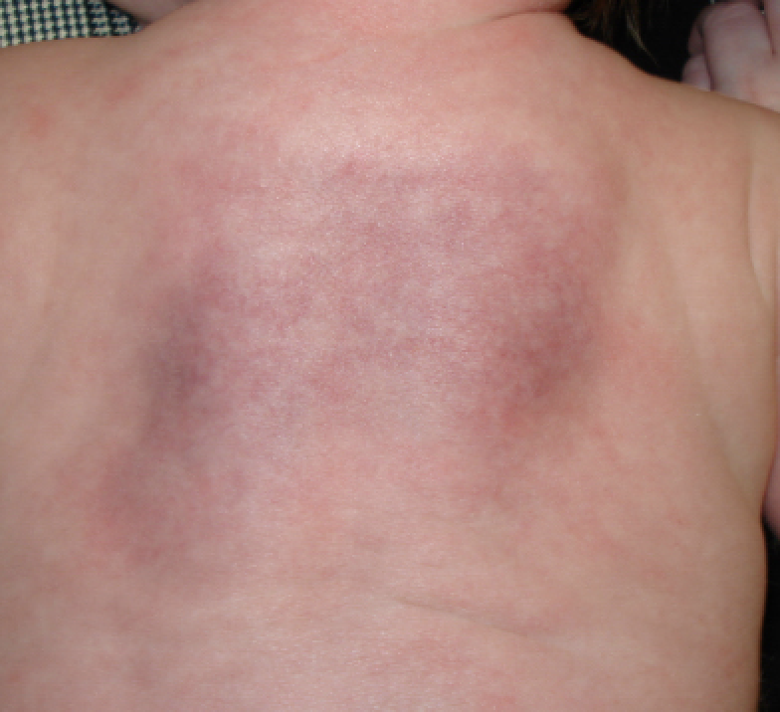
Case 1
A 2-day old female born at 40w6d with hypoxic ischemic encephalopathy treated with therapeutic hypothermia develops firm erythematous subcutaneous nodules on the back.
Which of the following is the most important lab to follow?
A) Hemoglobin
B) WBC count
C) Calcium
D) AST/ALT
E) Eosinophils

Slide 3
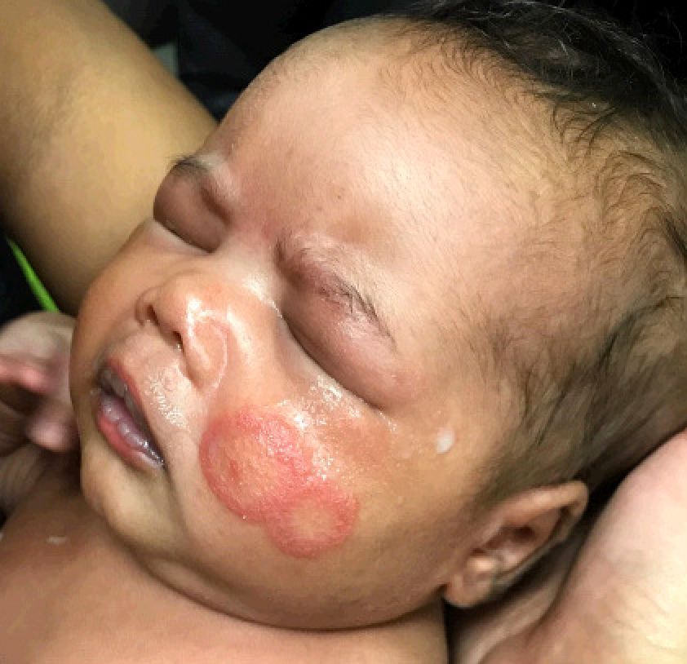
Case 2
A 16-day-old full-term female presents with a 3-day history of an annular rash on the left cheek.
What is the next best test?
A) Fungal culture
B) KOH
C) ANA
D) Anti-SSA/SSB
E) Anti-U1-RNP
F) EKG

Slide 4
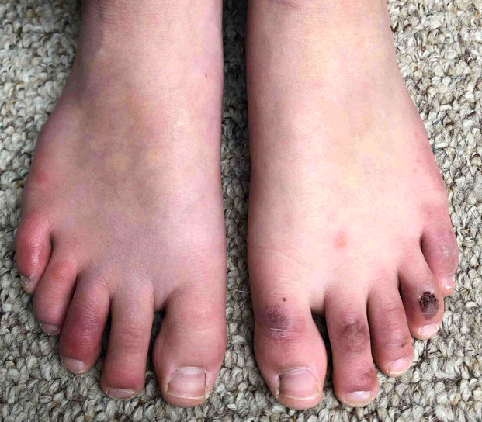
Case 3
A 13-year-old male with no PMHx presents with a 2-week history of tender violaceous nodules on the toes. Of note, his brother was diagnosed with COVID-19 2 months ago. There is no family history of autoimmune disease.
Which of the following is the most frequently associated lab abnormality?
A) Covid-19 PCR
B) D-dimer
C) ANA
D) Fibrinogen
E) None of the above

Slide 5
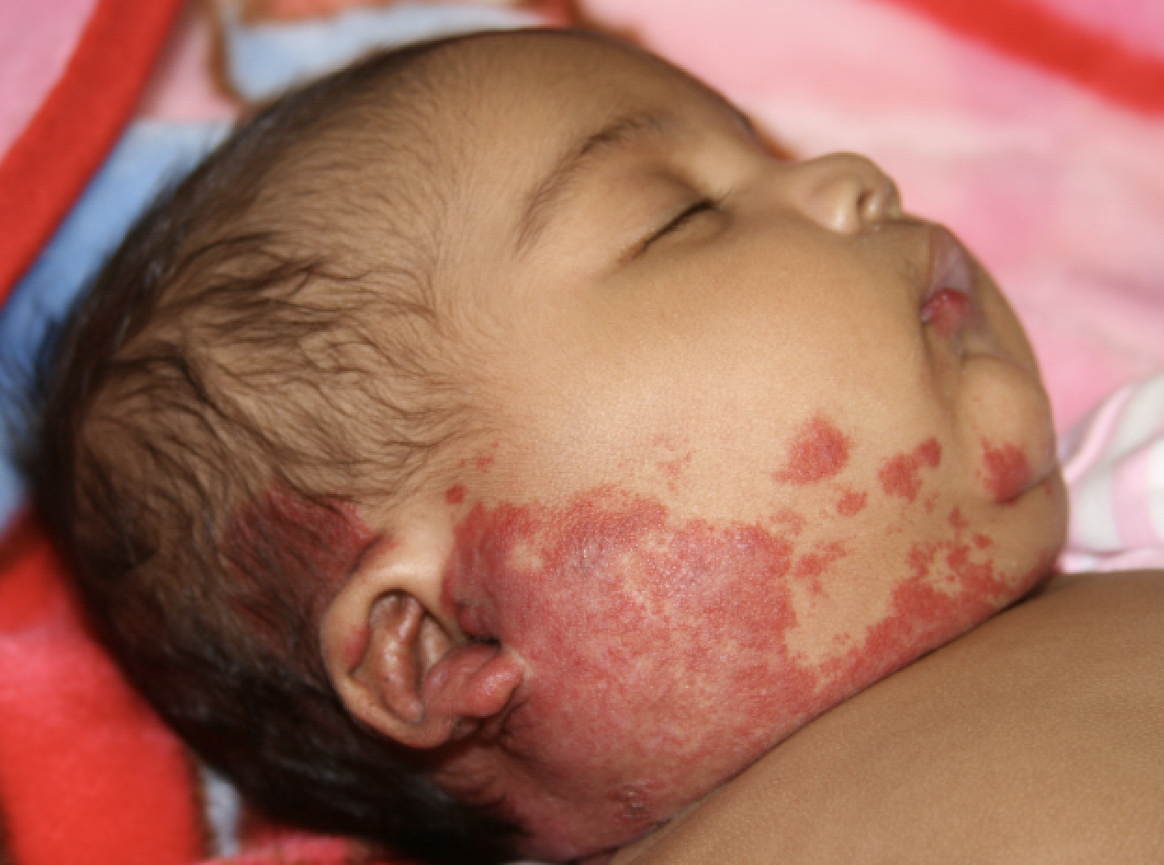
Case 4
A 26-day-old female presents for a birthmark. The family first noticed a pink patch at birth that is darkening and becoming more raised.
Which of the following is not an associated anomaly?
A) Dandy-Walker malformation
B) Coarctation of the aorta
C) Accessory tragus
D) Sternal defects
E) Retinal vascular anomalies
F) Ventricular septal defect

Slide 6
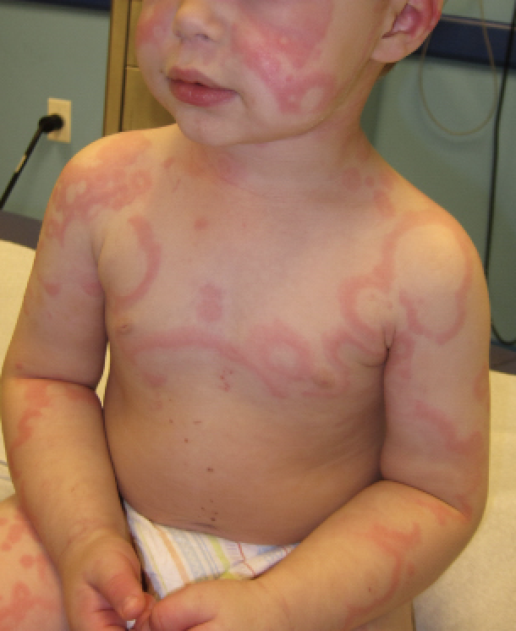
Case 5
A 16-month-old male presents with a new annular erythematous rash with hand and foot swelling, fevers, and arthralgias. He recently started amoxicillin for otitis media.
What is the most appropriate next step in management?
A) Biopsy
B) Cetirizine and Famotidine
C) Stop amoxicillin
D) A&C
E) B&C

Slide 7
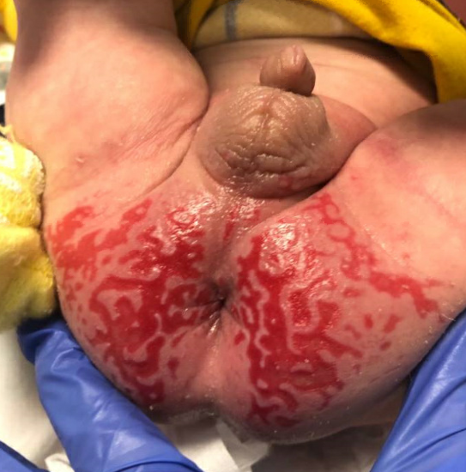
Case 6
A 4-month-old male with diarrhea, poor weight gain, and failure to thrive presents with a recurrent diaper rash.
What is the most likely cause?
A) Irritant dermatitis
B) Herpes simplex virus
C) Langerhans cell histiocytosis
D) Psoriasis
E) Acrodermatitis enteropathica

Slide 8
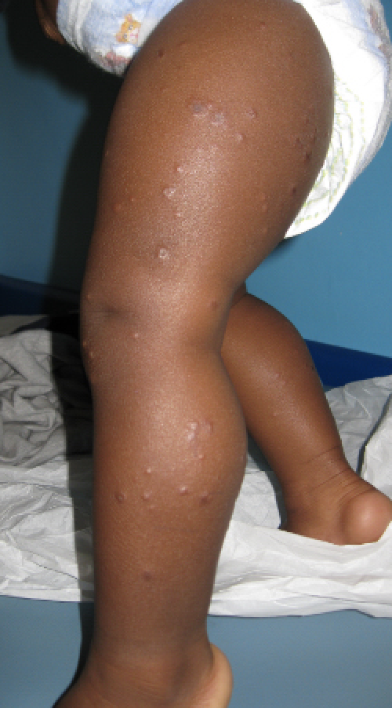
Case 7
A 7-month-old male with a new history of seizures recently started on phenobarbital presents with a new rash that spares the trunk. Patient is up-to-date on vaccinations.
What is the most common cause of this rash in the United States?
A) Hepatitis B virus
B) Epstein-Barr virus
C) Parvovirus B19
D) Group A β-hemolytic streptococci
E) MMR vaccine

Slide 9
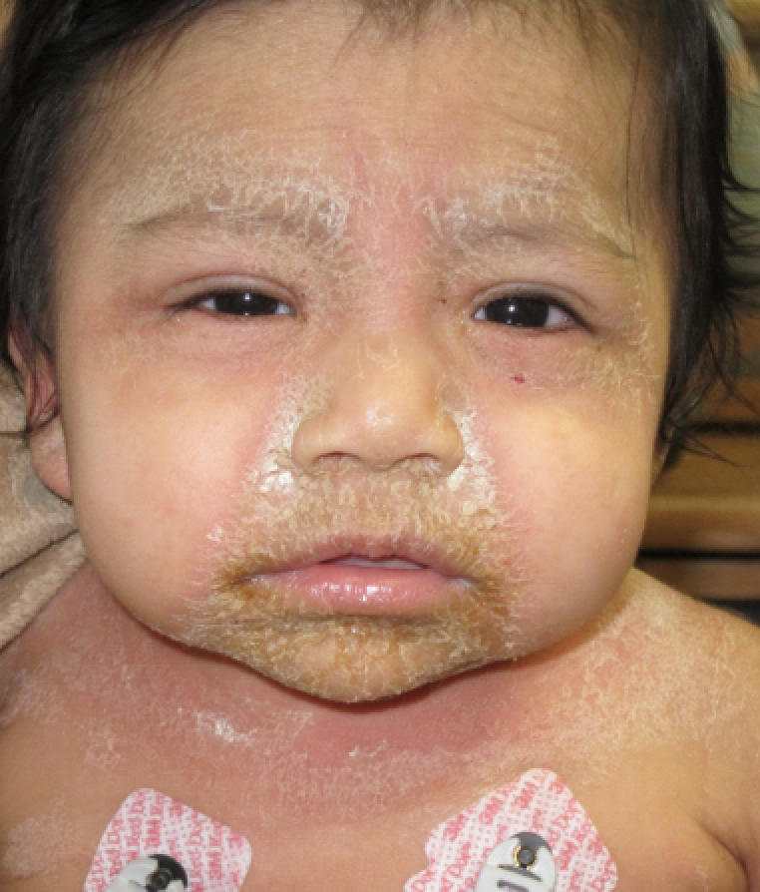
Case 8
A 28-month-old male presents with a pruritic erythematous rash on his face and intertriginous areas with new fever. Of note, he cut his forehead 7 days ago and mom has been applying mupirocin 2% ointment to the area.
Which location is least likely to yield a positive culture?
A) Nares
B) Umbilicus
C) Perianal
D) Axilla
E) Conjunctiva
F) Blood

Slide 10
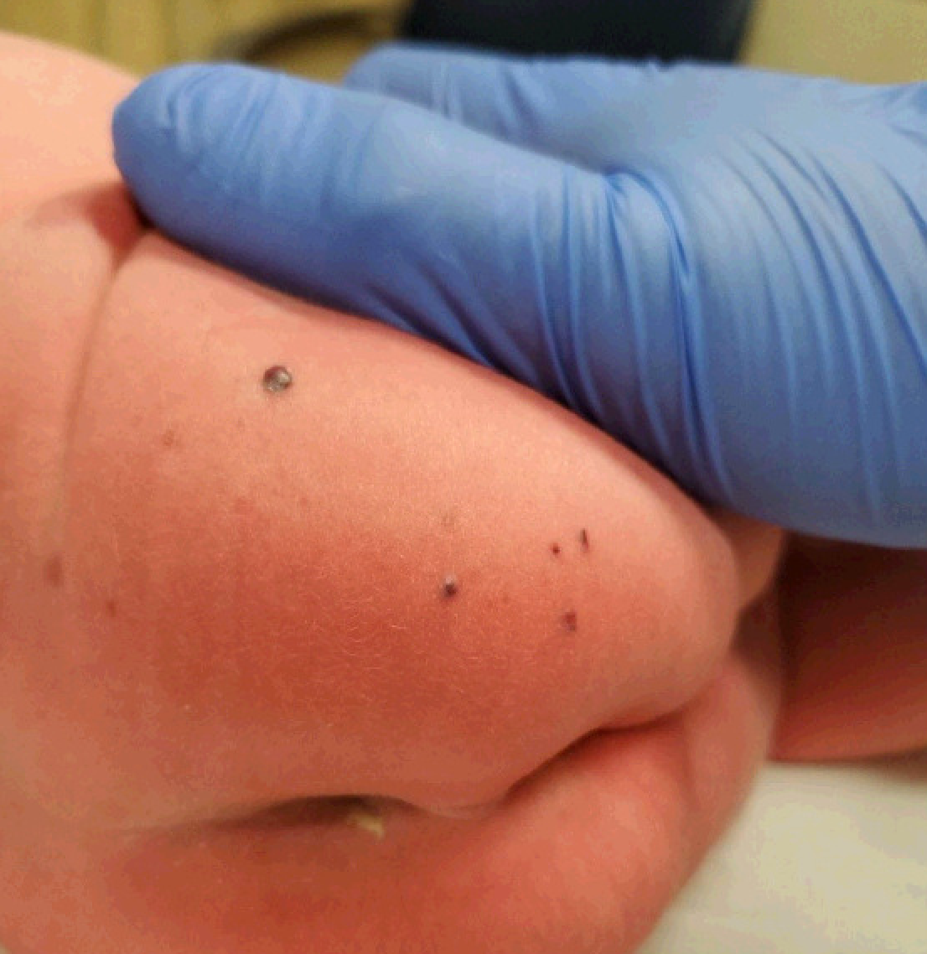
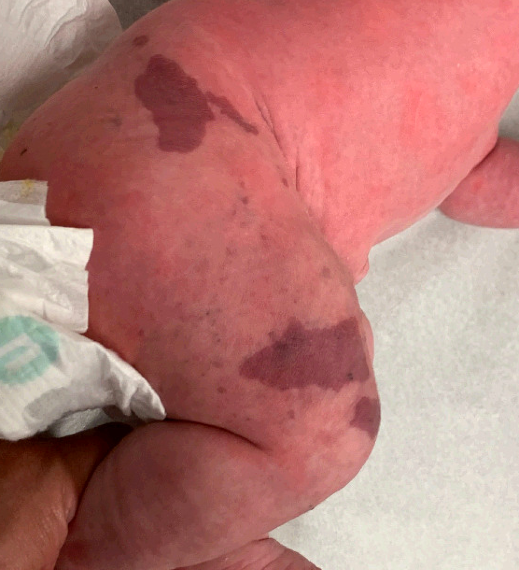
Case 9
An 8-day-old female presents for a birthmark on the right leg. Since onset, the area has darkened and subsequently developed dark purple papules.
What is the associated mutation?
A) RASA-1
B) PTEN
C) GNAQ
D) TEK
E) PIK3CA

Slide 11
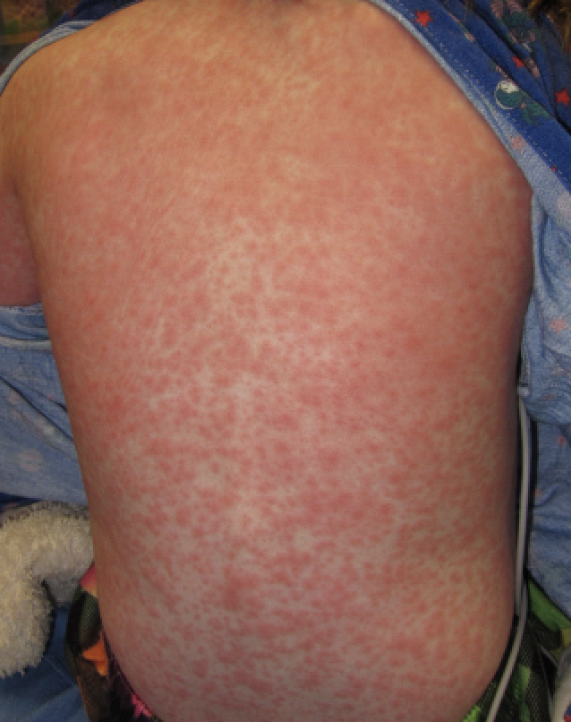
Case 10
A 16-year-old male presents with a 2-week history of worsening rash, fevers, and facial swelling. Patient was recently started on minocycline for acne 2 months ago. Labs are notable for WBC 11k, Eos 5%, AST 65, ALT 203. The patient was admitted for IV solumedrol and minocycline was discontinued.
Which test is the most important for long-term monitoring in this patient?
Hepatic function panel
Creatinine
CBC with diff
EKG
Thyroid function testing

Slide 12
See you soon for the answer session!

